Slide 1
Automated DOORBELL -a smart approach to doorbells..
mEMbers:
Rohan varadkar
Mohnish karri
Sourabh singh

Slide 2
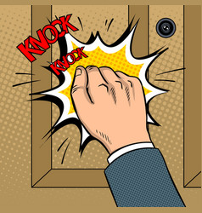
Premise : Ancient doorbell
Have you ever experienced the frustration of knocking some ones door constantly and realize lately, that there is no one inside ??

Slide 3
Did you ever miss an appointment with some one just because you were late by 5 minutes to reach home?
Wouldn’t it be nice if you could know who all have visited your house when you were at office ?

Slide 4
If you answered any of those questions with an yes, this product will be surely of your choice.

Slide 5
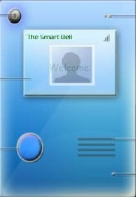
Camera->
Presenting the new generation smart doorbell..
<-Infrared sensor
LED display->
<-Speaker
Buzzer->
<-Microphone input

Slide 6
You think this is just an ordinary electronic door bell ?? …….Think Again !!

Slide 7
KEY FEATURES:
Auto detection of a person, when he comes in front of the door.
Takes photographs automatically.
Sends information collected to the house owner via email or other cloud services.

Slide 8
Key features continued..
If the owner wants, he can video chat with the person at the door.(This totally depends on how active the owner is at checking his/her emails/other notifs)
The owner can set his status about what time the owner returns home.
The bell can be re-functioned smartly using mobile applications(The power of IOT).

Slide 9
APPLICATIONS:
Residential flats.
Shopkeeper and store owners.(They can communicate with their customer remotely when their store remains closed)
ANY KIND OF ORDINARY BELL COULD BE REPLACED WITH THIS SMART BELL.

Slide 10
DOWNSIDES
Cost(for a basic version of this bell takes around 1500rs,where as a normal bell would be around 250rs, but comes with huge advantages for a time conservative person)
That’s it.

Slide 11
SO, LETS START KNOCKING THE SMART WAY………

Slide 12
THANKYOU

